Slide 1

RAJALAKSHMI ENGINEERING COLLEGE
DEPARTMENT OF MECHANICAL ENGINEERING
ME6811 – PROJECT WORK
Final Review

Slide 2
PROJECT TITLE
Optimization of the process parameters in End Milling of Al 6082 T6 using Taguchi methodology

Slide 3
PROJECT MEMBERS
Name Class Roll No Register No 1.Loksagar R S Mech B 201404097 211614114099 2.Sapthagirishsrinivas C Mech B 201404236 211614114701
PROJECT SUPERVISOR
Name Designation Department
1. Mr.M.Santhanakrishnan Assistant Professor Mechanical Department
PROJECT COORDINATORS
Name Designation Department
1.Dr.P.Chithambara Nathan Associate Professor Mechanical Department
2.Mr.K.Loganathan Assistant Professor (SS) Mechanical Department

Slide 4
ABSTRACT
Optimization of tool geometry and process parameters in end milling operation, the experiments were conducted on Aluminium Al 6082 to reduce the temperature rise and vibration occurring during machining process and optimizing the parameters by using Taguchi’s design of experiments and adequacy model was checked by analysis of variance (ANOVA). The temperature was measured by K type thermocouple and the vibration was measured by Kistler 8776 A50 accelerometer.

Slide 5
INTRODUCTION
End milling is the most frequent operation encountered, which was employed for making profiles, slots, engraves, contours and pockets in various components.
During the process, the heat generation occurs as a result of plastic deformation and friction along the tool chip and tool work piece interface.
Thermocouples is the most popular tools to be used in temperature measurements during machining
Accelerometers which provide the frequency of the vibration occurred during the machining.
To obtain better quality in machining, selection of optimum parameters becomes important.

Slide 6
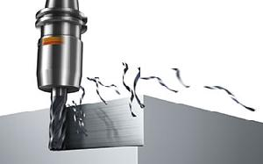
END MILLING
An end mill is a type of milling cutter, a cutting tool used in industrial milling applications. It is distinguished from the drill bit in its application, geometry, and manufacture. While a drill bit can only cut in the axial direction, a milling bit can generally cut in all directions, though some cannot cut axially. The high impact loads at entry as well as fluctuating cutting force makes the milling process subject to vibration and chatter. This aspect has great influence on the design of milling cutters. End milling is extensively employed in molds, dies, automotive, aerospace industries. In particular, this process is widely used in the aerospace industry due to the accuracy and complexity involved in the finished dimensions.

Slide 7
OBJECTIVES
To predict temperature rise and occurrence of vibration during milling in terms of process parameters such as rake angle, spindle speed, feed rate and axial depth of cut using Taguchi Methodology
To study the Direct and interaction effect of these parameters with rise in Cutting Temperature and vibration during milling.
To study the influence of individual factors on the performance and determine which factor has more influence, which ones have less.
To optimize the process parameters levels and also identifying the major parameter influencing better quality.

Slide 8
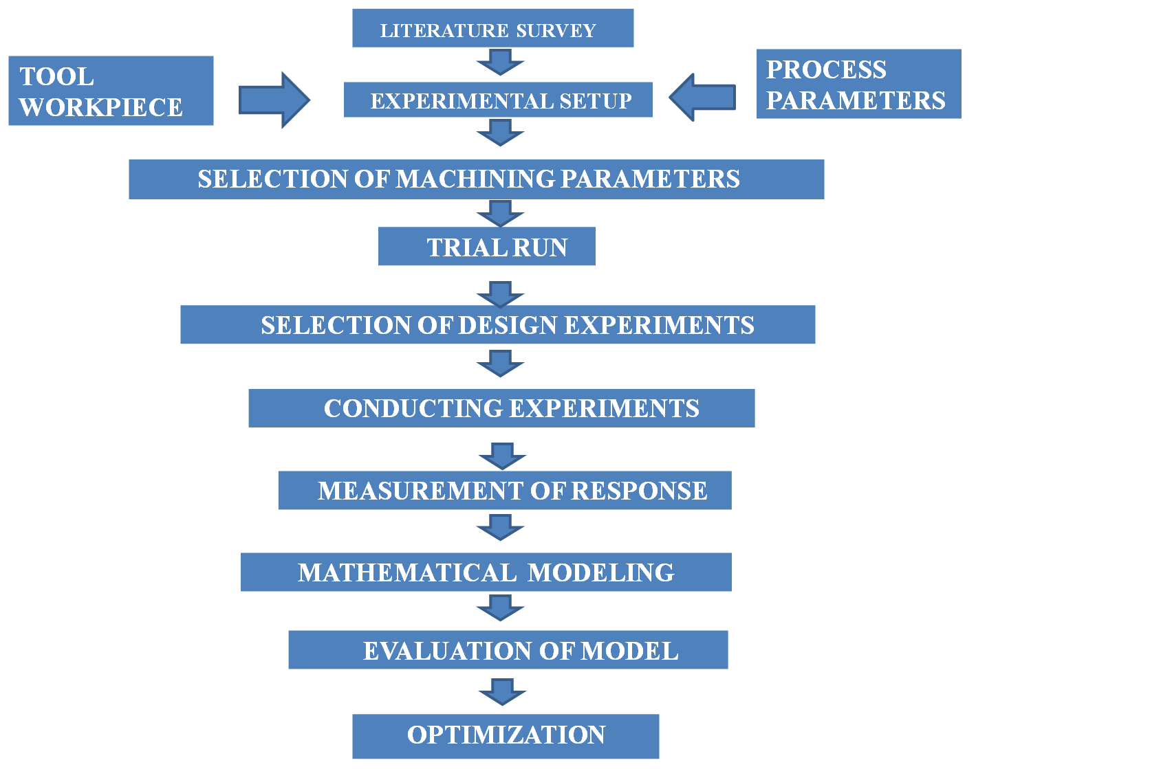
PROJECT METHODOLOGY

Slide 9
LITERATURE REVIEW
S.No | Author’s name | Title | Journal | Inference
1. | Tao huang, Xiao-ming zhang, Han ding | Tool orientation optimization for reduction of vibration and deformation in Ball-end milling of thin-walled impeller blades (2017) | Modeling of machining operations | A method of tool Orientation determination for vibration and deformation reduction during ball-end milling was developed by sequential linear programming
2. | Chengzhe jin, Chang guo, Yun gao | Research on cutting vibration characteristics of face-milling involute gear (2017) | Defense technology | Cutting vibration analysis was performed by quick sine frequency sweep method using Adams software

Slide 10
S.No | Author’s name | Title | Journal | Inference
3. | Di cui , Dinghua zhang, Baohai wu , Ming luo | An investigation of tool temperature in end milling considering the Flank wear effect (2017) | Mechanical sciences | Experimental and theoretical investigation of tool temperature in end milling. It predicts the sharp and worn tool temperature accurately of flank wear using temperature model
4. | P.M.Gopal, K.Soorya Prakash | Minimization of cutting force, temperature and surface roughness through GRA, topsis and taguchi techniques in end milling of mg hybrid mmc (2017) | Measurement | Effects of machining parameters on temperature by conducting milling experiments and thereby optimizing the multi model using grey relational analysis (GRA)& techniques for order preferences by similarity to ideal solution (topsis).

Slide 11
S.No | Author’s name | Title | Journal | Inference
5. | B. Rajeswari, K.S.Amirthagadeswaran | Experimental investigation of machinability characteristics and multi-response Optimization of end milling in aluminium composites using RSM based grey Relational analysis (2017) | Measurement | Investigation of machinability characteristics for better machining using response surface methodology (RSM) based grey relational analysis to solve multi response optimization problem
6. | Xing zhang, Jun zhang, Xiaowei zheng, Bo pang, Wanhua zhao | Tool orientation optimization of 5-axis ball-end milling based on an accurate cutter/workpiece engagement model (2017) | Manufacturing science and technology | Optimizing tool orientation to realize a high efficiency and accuracy machining with high order Taylor formula using improved analytical method

Slide 12
S.No | Author’s name | Title | Journal | Inference
7. | S.Wojciechowski , R.W. Maruda, S. Barrans, P. Nieslony, G.M. Krolczyk | Optimization of machining parameters during ball end milling of hardened steel With various surface inclinations (2017) | Measurement | Optimal selection of end milling parameters in terms of cutting forces and efficiency by giving various input parameters and optimizing the cutting forces by response surface method, based on the minimization of a total utility function
8. | W. Baohai, Cui di, H. Xiaodong, Z. Dinghua, T. Kai, | Cutting tool temperature prediction method using analytical model for end milling (2016) | Aeronautics | Prediction of cutting tool temperature. In this for increase temperature a prediction model considering real friction state and for decrease in temperature 1d plate heat convection is used.

Slide 13
S.No | Author’s name | Title | Journal | Inference
9. | Umut karaguzela, Mustafa Bakkala, Ehan Budakb | Modeling and measurement of cutting temperatures in milling (2016) | High performance cutting | A technique is proposed to measure the milling temperatures which is key factor in process optimization by developing analytical model using miniature data acquisition system (das)
10. | Andrzej weremczuka, Rafal rusineka, Jerzy warminski | The concept of active elimination of vibrations in milling process (2015) | Modeling of machining operations | Numerical studies of non linear model of milling to reduce the vibration level by active piezo elements with help of stability lobes diagram

Slide 14
S.No | Author’s name | Title | Journal | Inference
11. | A. Maurotto , C.T.Wickramarachchi | Experimental investigations on effects of frequency In ultrasonically-assisted end-milling of Alsi 316l (2015) | Ultrasonic | Effects of frequency in ultrasonic vibration assisted milling machine and it is compared with the conventional process and identified that it improves the surface roughness in within narrow range.
12. | Sen lin , Fangyupeng , Jiewen , Yizhiliu , Rongyan | An investigation of work piece temperature variation in end milling considering flank rubbing effect (2013) | Machine tools and manufacture | Theoretical and experimental prediction about the magnitude and distribution of temperature for improving performance of metal cutting process by using the thermal model to describe the cyclic variation of temperature

Slide 15
S.No | Author’s name | Title | Journal | Inference
13. | Emel kuram , babur ozcelik | Multi-objective optimization using taguchi based grey relational analysis for micro-milling of al 7075 material with ball nose end mill (2013) | Measurement | Study to understand the milling of Aluminium material by minimizing the factors using taguchi’s method and grey relation analysis
14. | Lohithaksha m maiyara, Dr.R.Ramanujam, K.Venkatesanc , Dr.J.Jeraldd | Optimization of machining parameters for end milling of Inconel 718 Super alloy using taguchi based grey relational analysis (2013) | Procedia engineering | Investigation study of optimization of end milling operation using grey relational analysis with multi performance characteristics. Anova model is also applied to select most significant factor

Slide 16
S.No | Author’s name | Title | Journal | Inference
15. | K.B. Mustapha , Z.W.Zhong | A hybrid analytical model for the transverse vibration response of a micro-end mill (2013) | Mechanical systems and signal processing | Hybrid analytical model which is the combination Of discrete and distributed elements for the frequency responses by making the use of root mean square value(RMS) for response
16. | R. Arokiadass, K. Palaniradja, N.Alagumoorthi | Prediction and optimization of end milling process parameters of Cast aluminium based mmc (2012) | Transaction of non ferrous metals | Investigation of end milling machining characteristics by experimental plan by standard response surface methodology design and obtaining the results variance by ANOVA model

Slide 17
S.No | Author’s name | Title | Journal | Inference
17. | Hui ding , Rasid Iibrahim Kaicheng , Shi-jinchen | Experimental study on machinability improvement of hardened tool steel using two dimensional vibration-assisted micro-end-milling (2010) | Machine tools and manufacture | Experimental study of effects of vibration parameters to improve surface roughness and also to reduce tool wear using 2d vibration assisted micro end milling
18. | T.Surmann, D.Biermann | The effect of tool vibration on the flank surface created by peripheral milling (2008) | Cirp annal Manufacturing technology | To predict and minimize the roughness and error on flank surface by optimizing the rotation speed and thereby reducing the vibration using stability charts

Slide 18
S.No | Author’s name | Title | Journal | Inference
19. | V. Tandon , El-mounayri H.Kishawy | Nc end milling optimization using evolutionary computation (2002) | Machine tools and manufacture | Particle swam optimization developed algorithm to optimize machining parameters using artificial neural network (ANN) predictive model
20. | Y .Aitintas, A. Spence, | End milling force algorithms for cad systems (1991) | Machine tools and manufacture | It provide an efficient milling mechanics simulation system for use with the solid model based tool path generation Algorithms ,using the constructive solid scheme.

Slide 19
SELECTION OF MATERIAL
The material chosen for our project is ALUMINIUM 6082 T6
Aluminium alloy 6082 is a medium strength alloy with excellent corrosion resistance. It has the highest strength of the 6000 series alloys. Alloy 6082 is known as a structural alloy. In plate form, Aluminium alloy 6082 is the alloy most commonly used for machining. As a relatively new alloy, the higher strength of Aluminium alloy 6082 has seen it replace 6061 in many applications. The addition of a large amount of manganese controls the grain structure which in turn results in a stronger alloy. The tighter chemical band ensures more consistent anodising between batches. T6 Solution heat treated and artificially aged.
Applications
Bridges ,Trusses, High stress applications, Cranes, Beer barrels, Milk churns and
Transport applications.

Slide 20
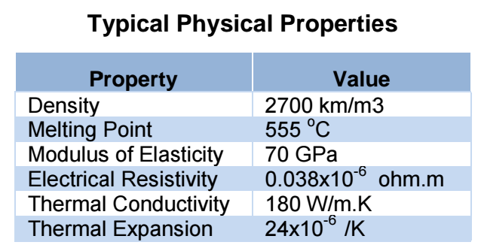
TYPICAL CHEMICAL COMPOSITION
Element % Present
Si 0.7 – 1.3
Fe 0.0 – 0.5
Cu 0.0 – 0.1
Mn 0.4 – 1.0
Mg 0.6 – 1.2
Zn 0.0 – 0.2
Ti 0.0 – 0.1
Cr 0.0 – 0.25
Al Balance

Slide 21
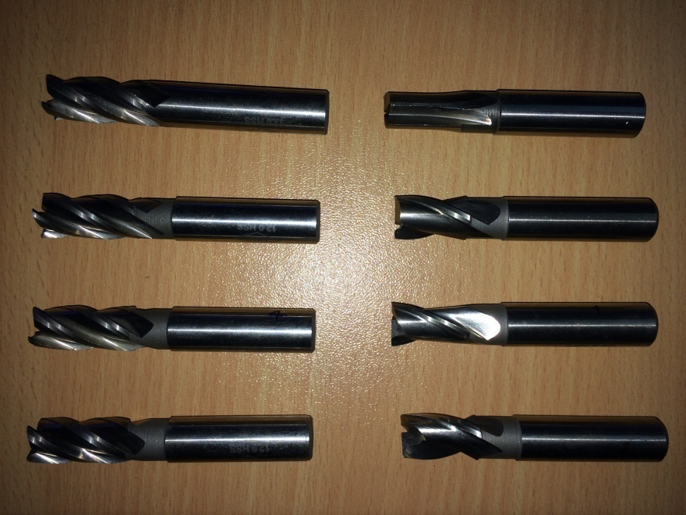
SELECTION OF END MILL CUTTER
We have chosen 2 flutes and 4 flutes HSS end mill cutter of 12 mm diameter and we are modifying the rake angle of tool in order to measure the responses at various levels of factors
In order to machine the work piece at various parameters we need 8 HSS tools with various rake angle and flutes.

Slide 22
Process Parameters considered
A. Rake angle
B. Feed rate
C. Spindle speed
D. Axial and Radial depth of cut

Slide 23
OBJECTIVE OF TAGUCHI METHOD
To determine the optimum combination of factors that yield a desired response and describes the response near the optimum
To determine how a specific response is affected by changes in the level of the factors over the specified levels of interest
To find the interaction effect of variables on the response.
Optimize product and process designs, study the effects of multiple factors (i.e.- variables, parameters, ingredients, etc.) on the performance, and solve production problems by objectively laying out the investigative experiments. (Overall application goals)
The prime motivation behind the Taguchi experiment design technique is to achieve reduced variation (also known as ROBUST DESIGN).

Slide 24
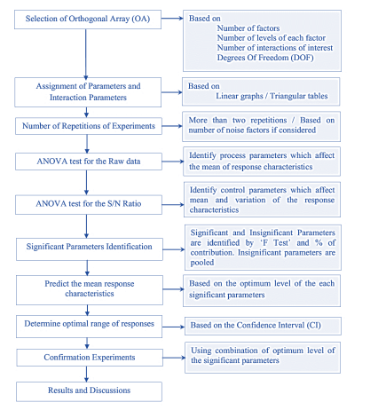
STEPS FOR TAGUCHI DOE

Slide 25
SELECTION OF PROCESS PARAMETERS
Machining Parameters and its Levels
Parameter | Units | Factor Levels
Rake angle(α) | Degree(°) | 4 | 8 | 12 | 16
Spindle Speed (N) | rpm | 2000 | 2500 | 3000 | 3500
Feed Rate (Z) | mm/rev | 0.02 | 0.03 | 0.04 | 0.05
Axial Depth of Cut (X) | mm | 1.5 | 2 | 2.5 | 3

Slide 26
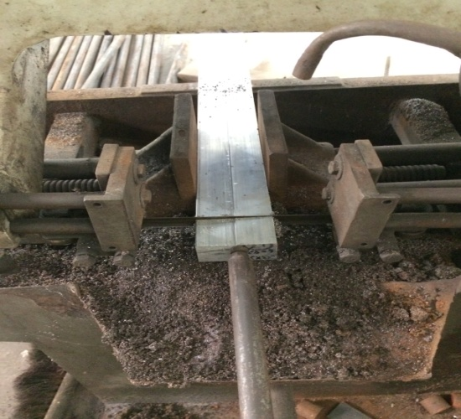
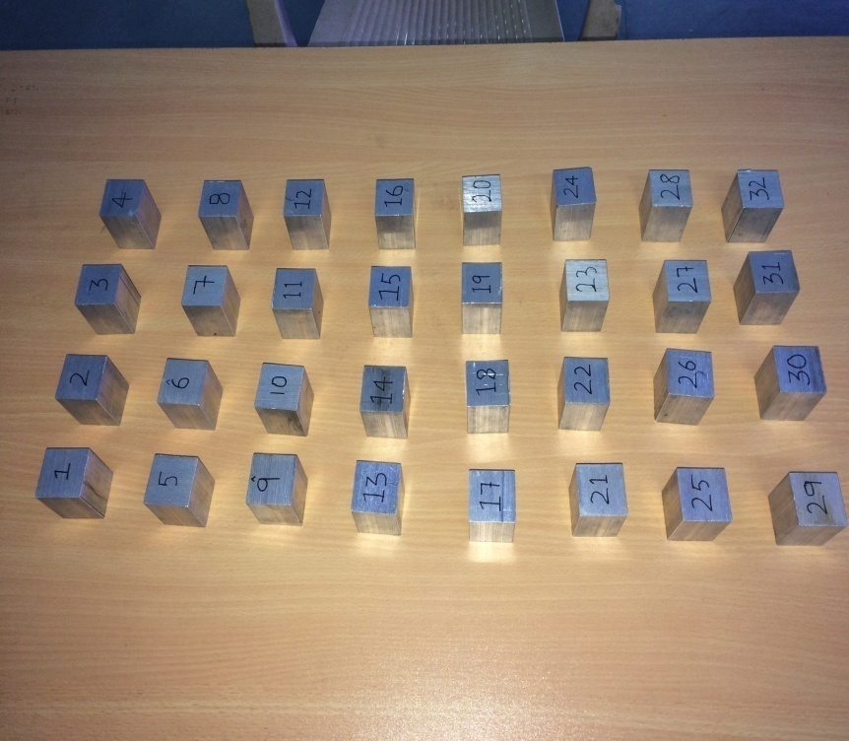
EXPERIMENTAL SETUP
Cutting of Al 6082 square rod
The Aluminium rod is cut into small workpieces of size
(32*32*40)mm

Slide 27
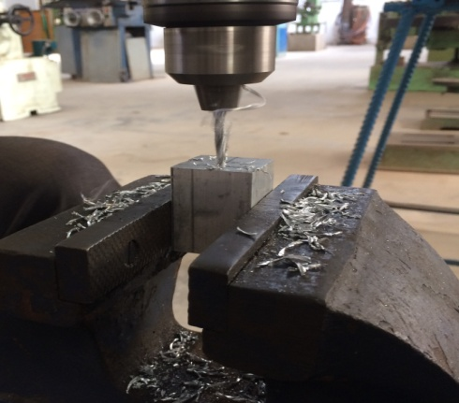
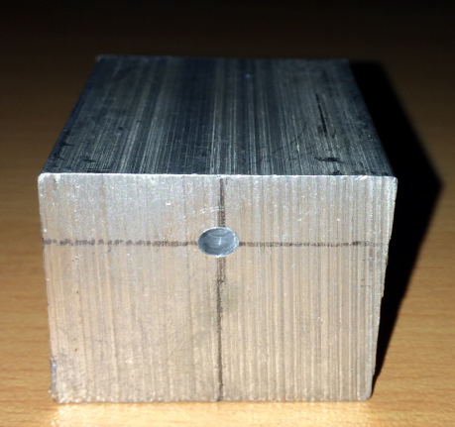
DRILLING OPERATION
In order to measure the temperature during end milling we have the drilled the workpiece with a 3.5mm drill bit with various height from the top surface to measure the temperature occurrence in various depth of cut. To predict the interior temperature during machining, we used a thermocouple of 3mm probe.

Slide 28
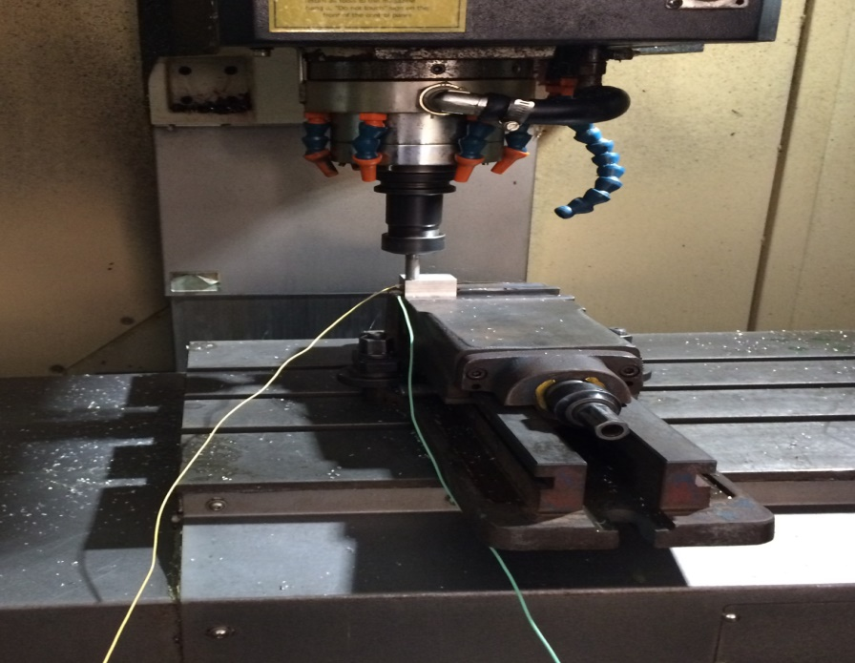
VERTICAL MACHINING CENTER
The work pieces have been machined with varying process parameters in various levels and the responses have been measured in form of Temperature in °c and Vibration in the form of acceleration (m/s²).

Slide 29
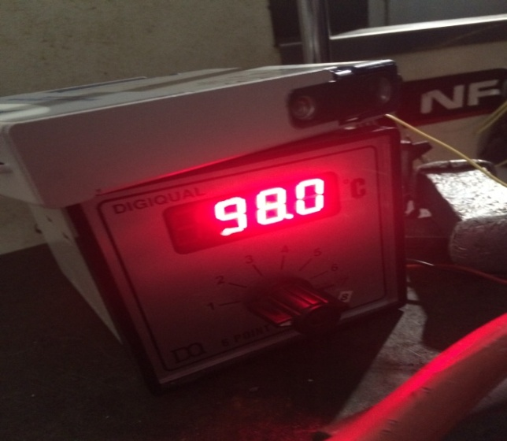
TEMPERATURE RESPONSE
The temperature rise in the aluminium workpiece is measured used k-type thermocouple and the temperature is indicated using temperature indicator.

Slide 30
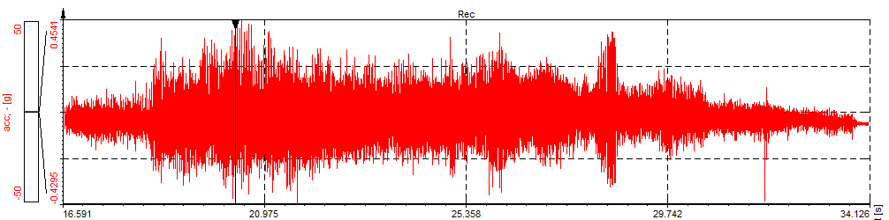
VIBRATION RESPONSE
The vibration occuring during machining is measured using
accelerometer and the response is given in terms of acceleration.

Slide 31
TAGUCHI OPTIMIZATION FOR 4 FLUTE
EXP | A | B | C | D | T °C | V m/s² | LOSS FN T°C | LOSS FN A m/s² | NORM LOSS T°C | NORM LOSS A m/s²
1 | 1 | 1 | 1 | 1 | 75.1 | 4.41 | 5640.01 | 19.4481 | 1.05286 | 11.8225
2 | 1 | 2 | 2 | 2 | 84.8 | 6.076 | 7191.04 | 36.9177 | 1.34053 | 22.4556
3 | 1 | 3 | 3 | 3 | 87.2 | 2.058 | 7603.84 | 4.23564 | 1.41993 | 2.69467
4 | 1 | 4 | 4 | 4 | 98.2 | 3.724 | 9643.24 | 13.8818 | 1.79703 | 8.54379
5 | 2 | 1 | 2 | 3 | 73.2 | 4.998 | 5358.24 | 24.98 | 1 | 15.3953
6 | 2 | 2 | 1 | 4 | 77.5 | 5.39 | 6006.25 | 29.0521 | 1.12097 | 17.8941
7 | 2 | 3 | 4 | 1 | 74.5 | 2.646 | 5550.25 | 7.00116 | 1.03535 | 4.13609
8 | 2 | 4 | 3 | 2 | 76.2 | 4.41 | 5806.44 | 19.4481 | 1.08647 | 1.19825
9 | 3 | 1 | 3 | 4 | 84.3 | 3.626 | 7106.49 | 13.1488 | 1.36273 | 8.10592
10 | 3 | 2 | 4 | 3 | 74.7 | 2.646 | 5580.09 | 7.00116 | 1.41404 | 4.31609
11 | 3 | 3 | 1 | 2 | 72.3 | 2.058 | 5975.29 | 4.23564 | 1.15159 | 2.60967
12 | 3 | 4 | 2 | 1 | 77.5 | 1.274 | 6006.25 | 1.62376 | 1.10937 | 1
13 | 4 | 1 | 4 | 2 | 78.8 | 1.568 | 6209.44 | 2.45624 | 1.18858 | 1.54793
14 | 4 | 2 | 3 | 1 | 76.9 | 1.372 | 5913.61 | 1.82384 | 1.13648 | 1.15763
15 | 4 | 3 | 2 | 4 | 95.3 | 3.43 | 9082.09 | 11.7649 | 1.69976 | 7.24521
16 | 4 | 4 | 1 | 3 | 93.4 | 2.352 | 8723.56 | 5.53194 | 1.68064 | 3.40284

Slide 32
TAGUCHI OPTIMIZATION FOR 2 FLUTE
EXP | A | B | C | D | T °C | V m/s² | LOSS FN T°C | LOSS FN A m/s² | NORM LOSS T°C | NORM LOSS A m/s²
1 | 1 | 1 | 1 | 1 | 79.8 | 3.332 | 6368.04 | 11.10222 | 1.025542 | 4.516
2 | 1 | 2 | 2 | 2 | 81 | 3.213 | 6561 | 10.32337 | 1.056617 | 4.199
3 | 1 | 3 | 3 | 3 | 81.8 | 3.234 | 6691.24 | 10.45876 | 1.077592 | 4.254
4 | 1 | 4 | 4 | 4 | 83.6 | 3.43 | 6988.96 | 11.7649 | 1.125538 | 4.785
5 | 2 | 1 | 2 | 3 | 80.8 | 2.646 | 6528.64 | 7.001316 | 1.051406 | 2.848
6 | 2 | 2 | 1 | 4 | 81.6 | 3.234 | 6658.56 | 10.45876 | 1.072329 | 4.254
7 | 2 | 3 | 4 | 1 | 78.8 | 1.568 | 6209.44 | 2.458624 | 1 | 1
8 | 2 | 4 | 3 | 2 | 80.4 | 1.96 | 6464.16 | 3.8416 | 1.041021 | 1.563
9 | 3 | 1 | 3 | 4 | 89.2 | 6.076 | 7956.64 | 36.91778 | 1.281378 | 15.02
10 | 3 | 2 | 4 | 3 | 87.6 | 4.018 | 7673.76 | 16.14432 | 1.235822 | 6.566
11 | 3 | 3 | 1 | 2 | 86 | 3.92 | 7396 | 15.3664 | 1.19109 | 6.25
12 | 3 | 4 | 2 | 1 | 84.4 | 3.332 | 7123.36 | 11.10222 | 1.147182 | 4.516
13 | 4 | 1 | 4 | 2 | 85.2 | 3.038 | 7259.04 | 9.229444 | 1.169033 | 3.754
14 | 4 | 2 | 3 | 1 | 86.4 | 3.142 | 7464.96 | 9.872164 | 1.202195 | 4.015
15 | 4 | 3 | 2 | 4 | 85.6 | 4.214 | 7327.36 | 17.7578 | 1.180036 | 7.223
16 | 4 | 4 | 1 | 3 | 84.4 | 4.324 | 7123.36 | 18.69698 | 1.147182 | 7.605

Slide 33
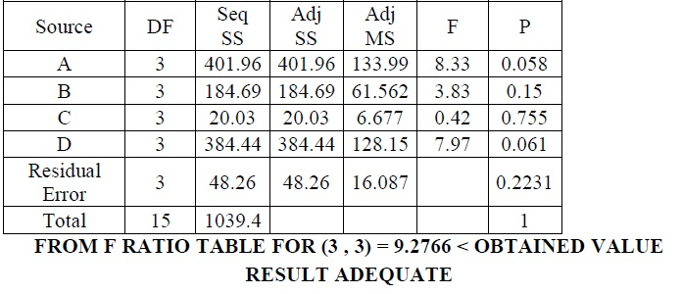
ANOVA FOR TEMPERATURE

Slide 34
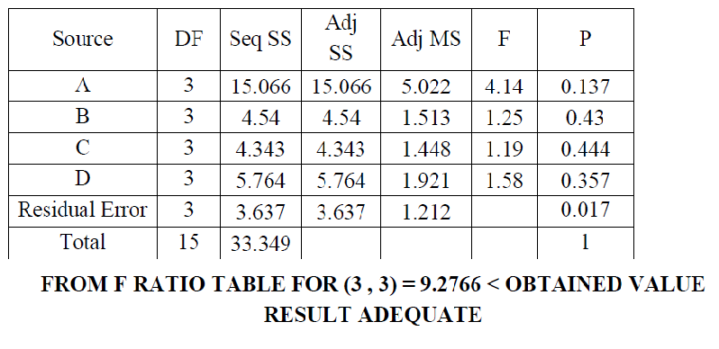
ANOVA FOR VIBRATION

Slide 35
CONCLUSION
All the four process parameters have an effect in determining the temperature rise and also in acceleration amplitude.
Effects of process parameters such as cutting speed, depth of cut, spindle speed exhibits positive value to the temperature rise and increase in frequency of vibration.
The effect of rake angle place a major role in machining as the increase in rake angle results in high temperature and in normal frequency of vibration.
While machining with 4 flute HSS tool the optimal parameter for end milling is spindle speed 2000 rpm, feed rate 0.03 mm/rev, depth of cut 2 mm, and rake angle 4 degree for minimal temperature and for minimal vibration the spindle speed is 3500 rpm, feed rate 0.03 mm, depth of cut 0.25 mm and rake angle 12 degree.
While machining with 2 flute HSS toll the optimal parameter for milling with minimal temperature and with low frequency of vibration is spindle speed 3000 rpm, feed rate 0.05 mm/rev, depth of cut 1mm and rake angle 8 degree.
Among the 2 flutes and 4 flutes HSS tool the 2 flute tool has minimal temperature rise and low frequency of vibration.

Slide 36
THANK YOU

